Slide 1

PIERIAN CLOUD

Slide 3

Google Cloud Associate Cloud Engineer
Google Cloud
and Cloud Computing

Slide 4
Google Cloud Associate Cloud Engineer
In this section of the course we’ll help you understand Cloud Computing, the Google Cloud Platform Infrastructure, and why you would want to choose Google Cloud Platform.
Note, we won’t need to log on to GCP yet, that will arrive in the next section!

Slide 5
Google Cloud Associate Cloud Engineer
Section Overview:
Cloud Computing
Google Cloud Infrastructure
Google Cloud Network Basics
Why Choose Google Cloud?

Slide 6
Google Cloud Associate Cloud Engineer
Let’s get started!

Slide 7
Google Cloud Associate Cloud Engineer
Cloud Computing

Slide 8
Google Cloud Associate Cloud Engineer
If your watching this course, you probably have some general idea of what cloud computing is.
But to continue the course, we should probably take a little bit of time to formally define what cloud computing is…

Slide 9

Google Cloud Associate Cloud Engineer
Fortunately for us, there is actually an entire government agency to help us out with this!

Slide 10
Google Cloud Associate Cloud Engineer
Created in 1901, the National Institute of Standards and Technology is an agency of the US Department of Commerce.

Slide 11
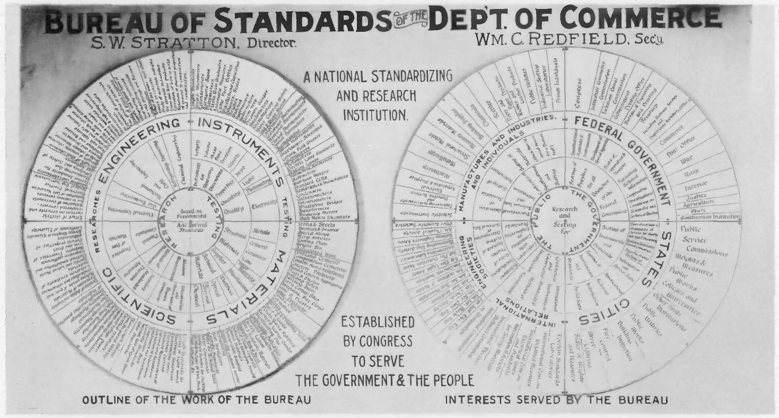
Google Cloud Associate Cloud Engineer
It’s important to have a common set of standards for communication and production.

Slide 12
Google Cloud Associate Cloud Engineer
In 2011, the NIST identified 5 important traits that constitute cloud computing:
On-demand self service
Broad Network Access
Resource Pooling
Rapid Elasticity
Measured Service

Slide 13
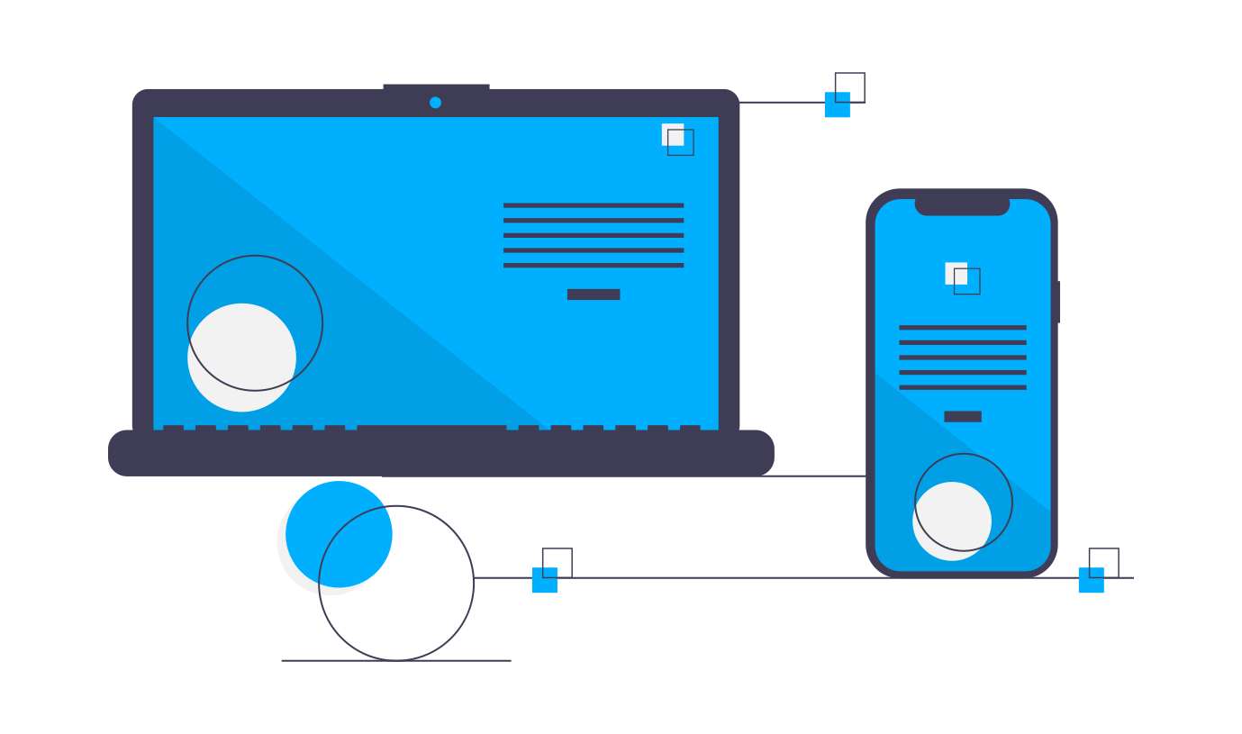
Google Cloud Associate Cloud Engineer
On-demand self service
Consumer can provision computing capabilities automatically, without requiring human interaction.

Slide 14
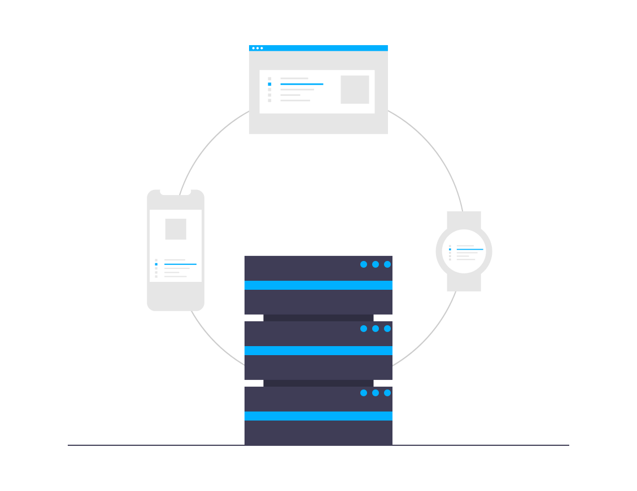
Google Cloud Associate Cloud Engineer
Broad Network Access
Capabilities are available over the network and access through standard mechanisms.

Slide 15
Google Cloud Associate Cloud Engineer
Resource Pooling
The cloud provider’s computing resources are pooled together to service multiple consumers and the consumer is independent of the geographical location of the computing resources.

Slide 16
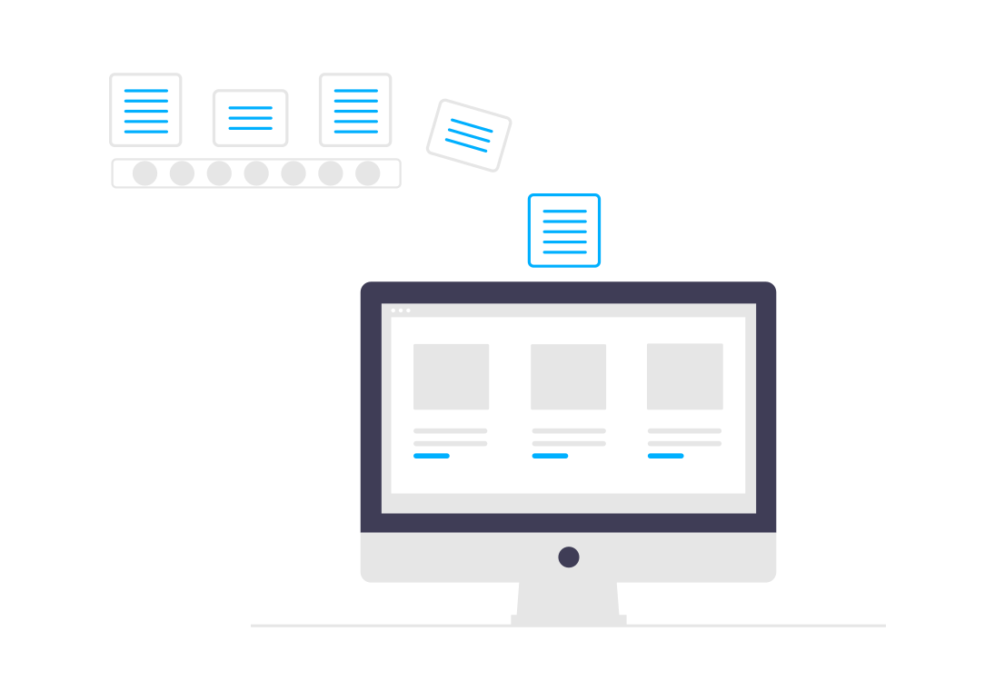
Google Cloud Associate Cloud Engineer
Rapid Elasticity
Capabilities can be elastically provisioned or released commensurate with demand.

Slide 17

Google Cloud Associate Cloud Engineer
Measured Service
Resource usage can be monitored and reported to the consumer.

Slide 18
Google Cloud Associate Cloud Engineer
Remember that any general cloud provider should have these characteristics:
On-demand self service
Broad Network Access
Resource Pooling
Rapid Elasticity
Measured Service

Slide 19
Google Cloud Associate Cloud Engineer
We now have answered:
“What is cloud computing?”
But more importantly, we need to answer:
“Why use cloud computing?”
If we can just buy computers ourselves, why “bother” with cloud computing?

Slide 20
Google Cloud Associate Cloud Engineer
Let’s explore a very brief history of cloud computing…

Slide 21
Google Cloud Associate Cloud Engineer
First Wave: Time-Sharing
Starting in the 1960s, companies like IBM and DEC created data centers with computing power that could use remote job entry to share computing resources among multiple users.

Slide 22

Google Cloud Associate Cloud Engineer
First Wave: Time-Sharing
Fun fact, there is a whole wikipedia article just on time-sharing!
en.wikipedia.org/wiki/Time-sharing

Slide 23
Google Cloud Associate Cloud Engineer
Second Wave: Virtualization
While the first wave of time sharing and colocation focused on a shared physical space, eventually software technology progressed enough to allow for virtualization.

Slide 24
Google Cloud Associate Cloud Engineer
Second Wave: Virtualization
The term “virtualization” has actually been around since the 1960s and 1970s, but the virtualization we describe here was popularized in the 1990s-2000s era.

Slide 25
Google Cloud Associate Cloud Engineer
Second Wave: Virtualization
Virtualization refers to the creation of a virtual machine that acts like a real computer with an operating system.
Software executed on these virtual machines is separated from the underlying hardware resources.

Slide 26
Google Cloud Associate Cloud Engineer
Second Wave: Virtualization
For example, a computer that is running Microsoft Windows may host a virtual machine that looks like a computer with the Ubuntu Linux operating system.

Slide 27
Google Cloud Associate Cloud Engineer
Second Wave: Virtualization
More importantly, in the second wave era of cloud computing, the actual compute resources (physical hardware) was still provider managed and maintained.

Slide 28
Google Cloud Associate Cloud Engineer
Second Wave: Virtualization
You can think of this era in terms of early silicon valley tales where founders talk about “having to rack our own servers”.

Slide 29
Google Cloud Associate Cloud Engineer
Clearly the first wave was not scalable with the requirement of physical access, and the second wave still requires maintenance of an actual physical device (e.g. what happens if the building with the hardware gets flooded?)

Slide 30
Google Cloud Associate Cloud Engineer
Third Wave: Serverless
A cloud provider allocates machine resources and compute capabilities on demand and takes care of the server hardware on behalf of the customer.

Slide 31
Google Cloud Associate Cloud Engineer
Third Wave: Serverless
The actual name “serverless” is a bit of a misnomer, as clearly there are still real physical hardware servers, it’s just that the client does not need to worry about the physical server, thus the term “serverless”.

Slide 32
Google Cloud Associate Cloud Engineer
Third Wave: Serverless
Google Cloud itself follows a serverless approach with a container based approach.
We’ll discuss containers in more detail later on.

Slide 33
Google Cloud Associate Cloud Engineer
Review:
We now understand the official definition of cloud computing.
We also understand the benefits of cloud computing from a historical perspective.

Slide 34
Google Cloud Associate Cloud Engineer
Up next:
Let’s explore more specifics about Google Cloud and its infrastructure and architecture!

Slide 35
Google Cloud Associate Cloud Engineer
Google Cloud
Network Infrastructure

Slide 36
Google Cloud Associate Cloud Engineer
Does every company require the cloud?

Slide 37
Google Cloud Associate Cloud Engineer
Will every company require the cloud?

Slide 38
Google Cloud Associate Cloud Engineer
Will every company require the cloud?
Google believes that almost every company can benefit from their data.
Understanding your data, such as sales, products, and customers can become a defining competitive factor in the future!

Slide 39
Google Cloud Associate Cloud Engineer
While at first glance a company may not seem data-centric, as we think deeper about competitive advantages, data and software become key components of strategy.

Slide 40
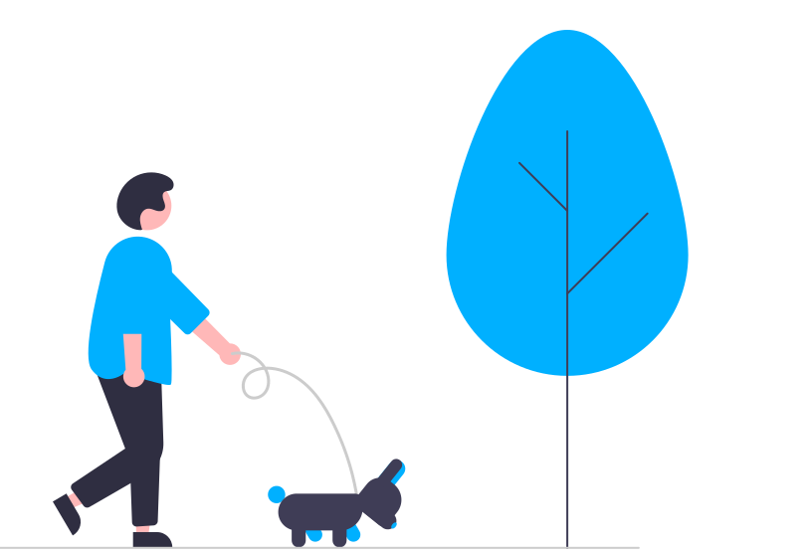
Google Cloud Associate Cloud Engineer
For example, a dog walking company may seem simple at first, but there are many data points to consider!

Slide 41
Google Cloud Associate Cloud Engineer
Dog walkers, routes, schedule matching, marketplace balancing are just a few data factors to consider as the company grows.

Slide 42
Google Cloud Associate Cloud Engineer
Clearly the better a company can manage and utilize their data, the better they can service their customers.

Slide 43
Google Cloud Associate Cloud Engineer
We know Google Cloud Platform has a variety of services and products, but what is Google Cloud Platform in the real physical world?
Where are the computers and how is the network connected through infrastructure?

Slide 44
Google Cloud Associate Cloud Engineer
First, we need to think about what a cloud platform is from a first principles standpoint.
Its essentially a connection from your computer to one of Google’s computers.

Slide 45
Google Cloud Associate Cloud Engineer
First, we need to think about what a cloud platform is from a first principles standpoint.
Its essentially a connection from your computer to one of Google’s computers.
How do we connect computers through the entire world?

Slide 46

Google Cloud Associate Cloud Engineer
In a 2006 hearing on net neutrality, Senator Ted Stevens famously remarked that the internet was - “It's a series of tubes.”

Slide 47
Google Cloud Associate Cloud Engineer
While Senator Stevens (born in 1923) is not really correct in his statement, it does make one wonder, what is the internet?

Slide 48
Google Cloud Associate Cloud Engineer
How do we connect computers across countries and oceans?
We know the internet existed before satellite based internet technology, so how are all of these computers connected and how can we connect to the Google Cloud platform?

Slide 49
Google Cloud Associate Cloud Engineer
We can think of the internet as a simple connection between two computers, often physically connected through a complex series of fiber optic cables.

Slide 50
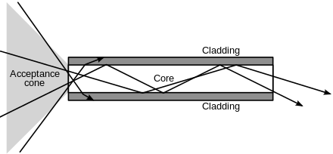
Google Cloud Associate Cloud Engineer
Fiber optic cables use a cabling made of glass or plastic to send pulses of light across a distance.

Slide 51
Google Cloud Associate Cloud Engineer
You can think of the light “bouncing” around the cable as its reflected internally until it comes out the other side.

Slide 52

Google Cloud Associate Cloud Engineer
You can think of the light “bouncing” around the cable as its reflected internally until it comes out the other side.

Slide 53
Google Cloud Associate Cloud Engineer
We can then time theses pulses to send information in binary terms (0 or 1, No Light or Light).

Slide 54
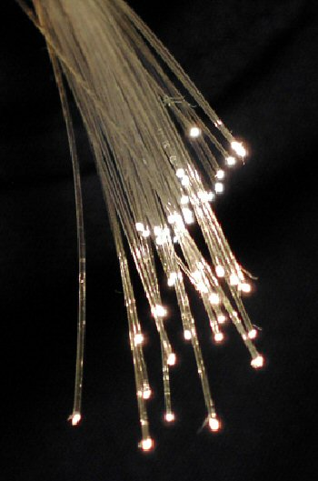
Google Cloud Associate Cloud Engineer
You’ve probably even had a chance to play with optical fiber in some toys!

Slide 55
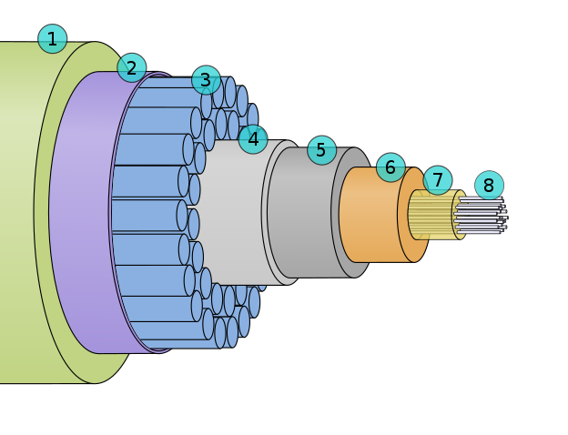
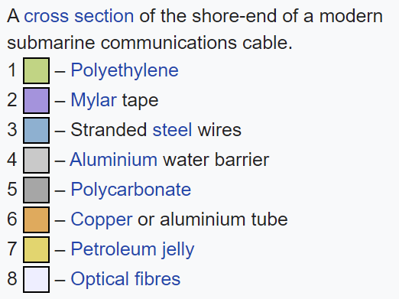
Google Cloud Associate Cloud Engineer
The optical fiber itself can be fragile, so if we want to lay across vast distances, we need to wrap it inside a cable:

Slide 56
Google Cloud Associate Cloud Engineer
Notice how the diagram legend mentions “submarine” communication cable.

Slide 57
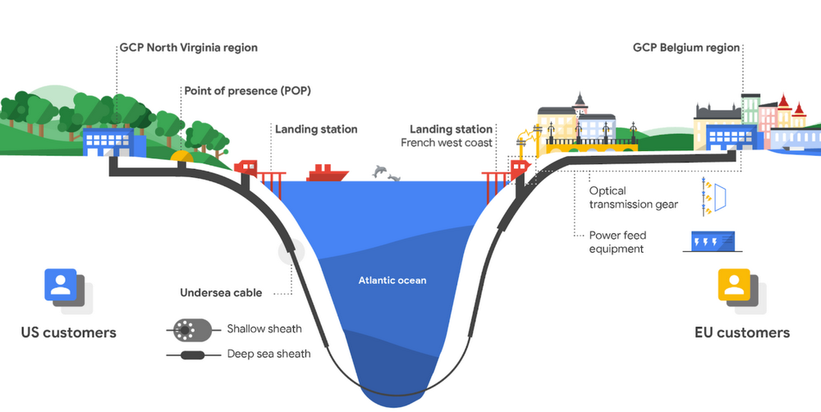
Google Cloud Associate Cloud Engineer
Google itself lays down cables across oceans!

Slide 58
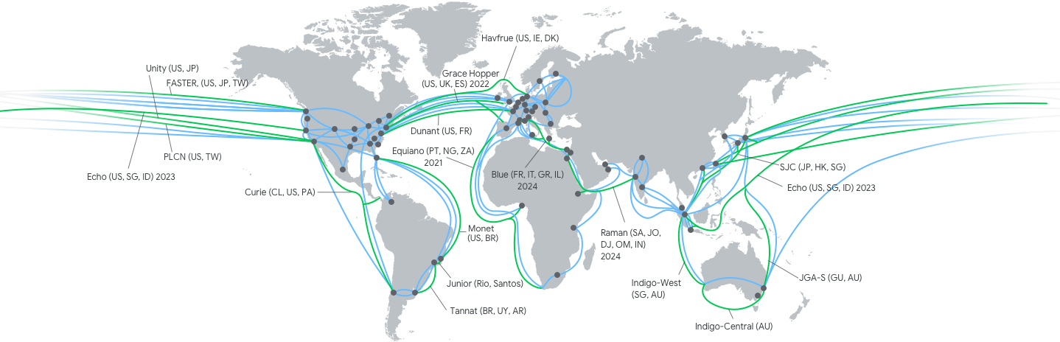
Google Cloud Associate Cloud Engineer
Google itself lays down cables across countries and oceans!

Slide 59
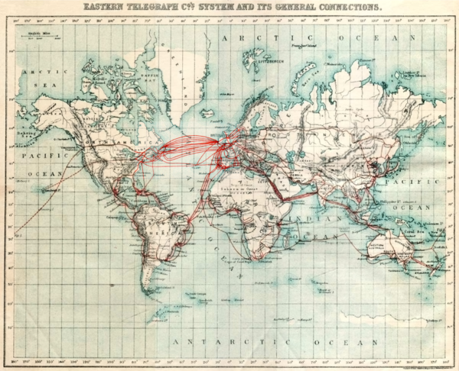
Google Cloud Associate Cloud Engineer
Note that Google did not invent the concept of subsea cable communication!
Eastern Telegraph Company network in 1901.

Slide 60
Google Cloud Associate Cloud Engineer
When we want to connect to Google Cloud we follow a specific path protocol for the most efficient routes.
Google Cloud is divided into Regions and Zones.
cloud.google.com/compute/docs/ regions-zones

Slide 61
Google Cloud Associate Cloud Engineer
Regions and Zones:
A Region is a specific geographical location where you can host your resources.
Regions can have three or more zones.

Slide 62
Google Cloud Associate Cloud Engineer
Regions and Zones:
For example, the us-west1 region denotes a region on the west coast of the United States that has three zones: us-west1-a , us-west1-b , and us-west1-c .

Slide 63
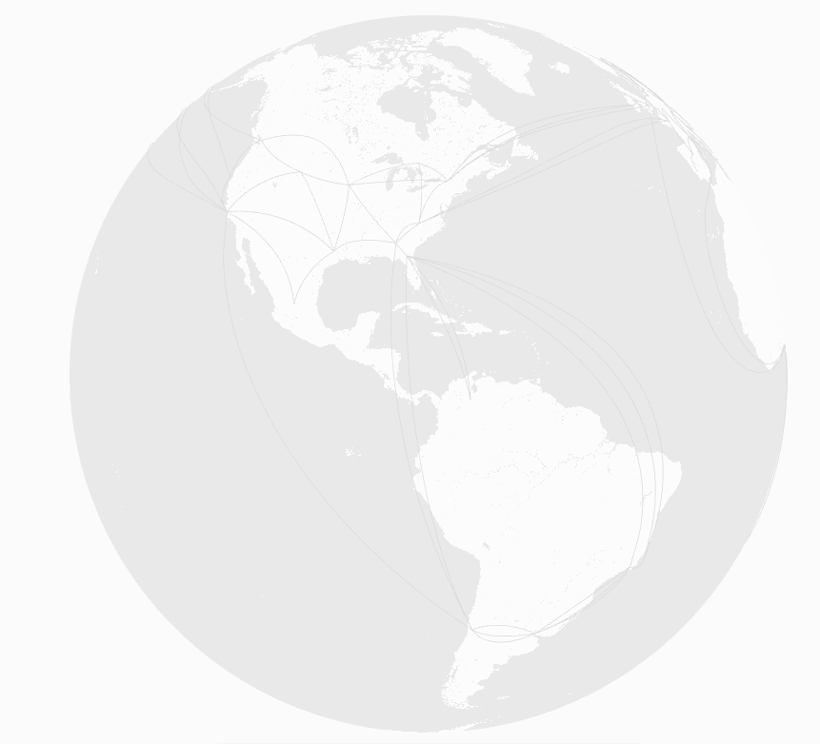
Google Cloud Associate Cloud Engineer
Regions and Zones:

Slide 64
Google Cloud Associate Cloud Engineer
Regions and Zones:
World

Slide 65
Google Cloud Associate Cloud Engineer
Regions and Zones:
World

Slide 66
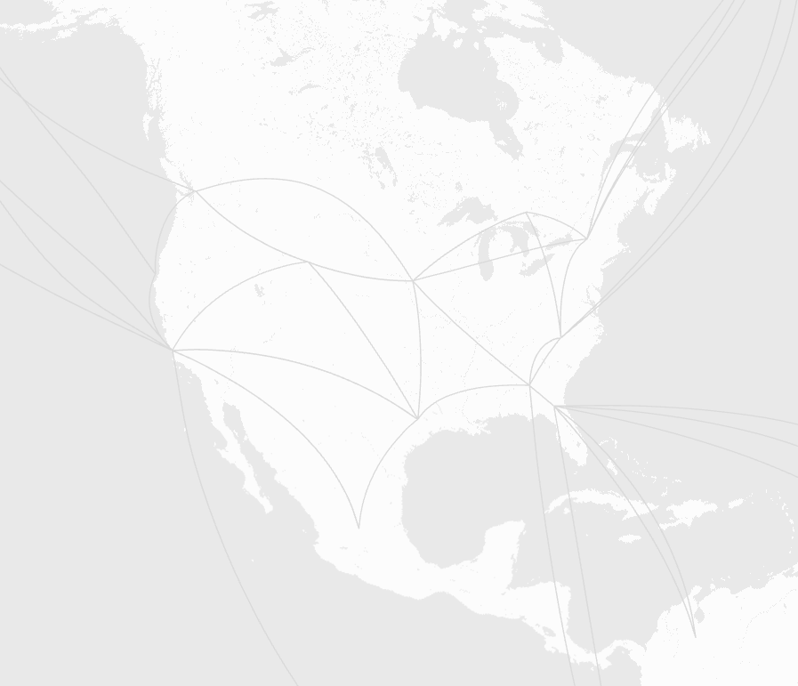
Google Cloud Associate Cloud Engineer
Regions and Zones:
World
Multi-Region
(North America)

Slide 67
Google Cloud Associate Cloud Engineer
Regions and Zones:
World
Multi-Region
(North America)

Slide 68
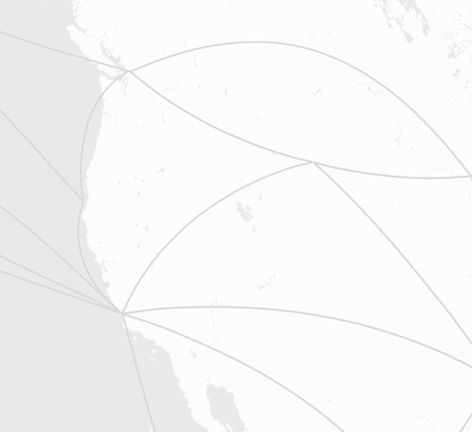
Google Cloud Associate Cloud Engineer
Regions and Zones:
World
Multi-Region
(North America)
Region
(us-west1)

Slide 69
Google Cloud Associate Cloud Engineer
Regions and Zones:
us-west1-a
us-west1-b
us-west1-c
World
Multi-Region
(North America)
Region
(us-west1)
Zones

Slide 70

Google Cloud Associate Cloud Engineer
Sometimes users equate a zone as a representation of a single GCP Data Center.
us-west1-a

Slide 71
Google Cloud Associate Cloud Engineer
Not necessarily the case due to a zone not corresponding to a single physical location.
us-west1-a

Slide 72
Google Cloud Associate Cloud Engineer
Regions and Zones:
us-west1-a
us-west1-b
us-west1-c
World
Multi-Region
(North America)
Region
(us-west1)
Zones

Slide 73
Google Cloud Associate Cloud Engineer
All zones have very fast connectivity between them, typically less than 5ms for a round trip of a signal.
Zones are single failure domains within a region.
For fault tolerance, we can spread applications across multiple zones.

Slide 74
Google Cloud Associate Cloud Engineer
We can also run applications across different regions.
GCP customers with a wide international presence will do this to better support their own customers in different countries.

Slide 75
Google Cloud Associate Cloud Engineer
Multi-Regions (e.g. Europe, North America, etc…) are collections of regions.
We can store data with GCP storage in a multi-region for redundancy.
Regions are guaranteed to be at least 160km apart.

Slide 76
Google Cloud Associate Cloud Engineer
Review:
We learned that GCP uses connected Zones within Regions to store data and compute power.
Regions are geographical locations hosting resources with at least three zones.

Slide 77
Google Cloud Associate Cloud Engineer
Up Next:
We’ll learn about the specific networking path GCP uses to connect users to the cloud!

Slide 78
Google Cloud Associate Cloud Engineer
Google Cloud
Network Connections

Slide 79
Google Cloud Associate Cloud Engineer
In the previous lecture we discussed Regions and Zones, where Regions are geographically separated areas with at least three zones.
We also learned that a lot of the infrastructure behind GCP is delivered by fiber optic cables.

Slide 80
Google Cloud Associate Cloud Engineer
Quick Review:
A Zone is a deployment area for GCP within a Region.
It is the smallest entity in the GCP network infrastructure.

Slide 81
Google Cloud Associate Cloud Engineer
Quick Review:
A Region is a geographical area (e.g. US-West, EU-West,etc..) that contains 3 or more zones.

Slide 82
Google Cloud Associate Cloud Engineer
Quick Review:
A Multi-Region are large geographical areas that contain multiple regions.

Slide 83
Google Cloud Associate Cloud Engineer
Regions and Zones:
us-west1-a
us-west1-b
us-west1-c
World
Multi-Region
(North America)
Region
(us-west1)
Zones

Slide 84
Google Cloud Associate Cloud Engineer
If we want to connect to GCP, maybe to use a service like BigQuery, are we able to connect directly to the data center?

Slide 85
Google Cloud Associate Cloud Engineer
If we want to connect to GCP, maybe to use a service like BigQuery, are we able to connect directly to the data center?
No, as this would require too many direct connections, instead we follow a step by step pathway which is the same no matter where we are located.

Slide 86
Google Cloud Associate Cloud Engineer
We saw a bit of this pathway already!

Slide 87
Google Cloud Associate Cloud Engineer
Let’s discuss the steps in more detail!

Slide 88
Google Cloud Associate Cloud Engineer
Requests to GCP pass through Edge Points of Presence (POPs) and can also use Edge Nodes (Google Global Cache, or GGC).
Quick Note:
You’ll also see Edge Nodes often referred to as a CDN - Content Delivery Network.

Slide 89
Google Cloud Associate Cloud Engineer
Let’s discuss these Edge POPs and Edge Nodes in more detail and then consider some hypothetical scenarios.

Slide 90
Google Cloud Associate Cloud Engineer
Requests to GCP first pass through edge POPs (Point of Presence) where Google’s network is connected to the rest of the internet via peering.

Slide 91
Google Cloud Associate Cloud Engineer
Requests to GCP first pass through edge POPs (Point of Presence) where Google’s network is connected to the rest of the internet via peering.
Peering:
Can have different meanings depending on the context!

Slide 92
Google Cloud Associate Cloud Engineer
Requests to GCP pass through edge POPs (Point of Presence) where Google’s network is connected to the rest of the internet via peering.
Peering with Internet Service Provider
Agreements with Google and ISPs for connections from client to ISP to GCP.

Slide 93
Google Cloud Associate Cloud Engineer
Side notes on peering:
Often two competing ISPs will interconnect for mutual benefit, this can be referred to as peering.
An issue regarding net neutrality was to what degree do ISPs need to allow free peering (e.g. Netflix traffic on Comcast networks).

Slide 94
Google Cloud Associate Cloud Engineer
Point of Presence

Slide 95
Google Cloud Associate Cloud Engineer
What if some content hosted on Google Cloud was very popular in a particular region?
Like a government website, a daily newspaper front page, or even a common Google Search, like a city map.
Would it still make sense to have to “ping” all the way back to a GCP Zone?

Slide 96
Google Cloud Associate Cloud Engineer
What if some content hosted on Google Cloud was very popular in a particular region?
It would be a lot more efficient to create a network of edge nodes that cache (save) a copy of that common and static (unchanging) information.

Slide 97
Google Cloud Associate Cloud Engineer
Google’s network of edge nodes that cache common static information is known as the Google Global Cache or GGC.
You will also see this referred to as Google Content Delivery Network (CDN).

Slide 98
Google Cloud Associate Cloud Engineer
How many POPs and how many GGC nodes are there?

Slide 99
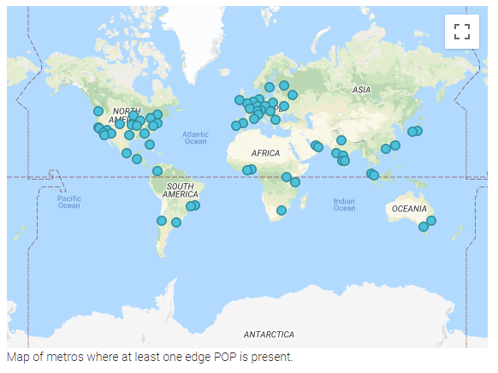
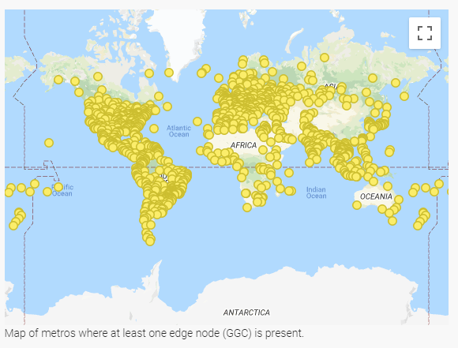
Google Cloud Associate Cloud Engineer
How many POPs and how many GGC nodes are there?

Slide 100
Google Cloud Associate Cloud Engineer
Clearly quite a bit of content is cached on the edge nodes for quick retrieval!

Slide 101
Google Cloud Associate Cloud Engineer
Now let’s imagine some hypothetical network connection paths…

Slide 102
Google Cloud Associate Cloud Engineer
Network Connection Path
Let’s imagine you are hosting a simple web application with some static content on Google Cloud and a visitor wants to view your webpage.
Let’s explore the typical pathway…

Slide 103

Google Cloud Associate Cloud Engineer
Network Connection Path
Client

Slide 104
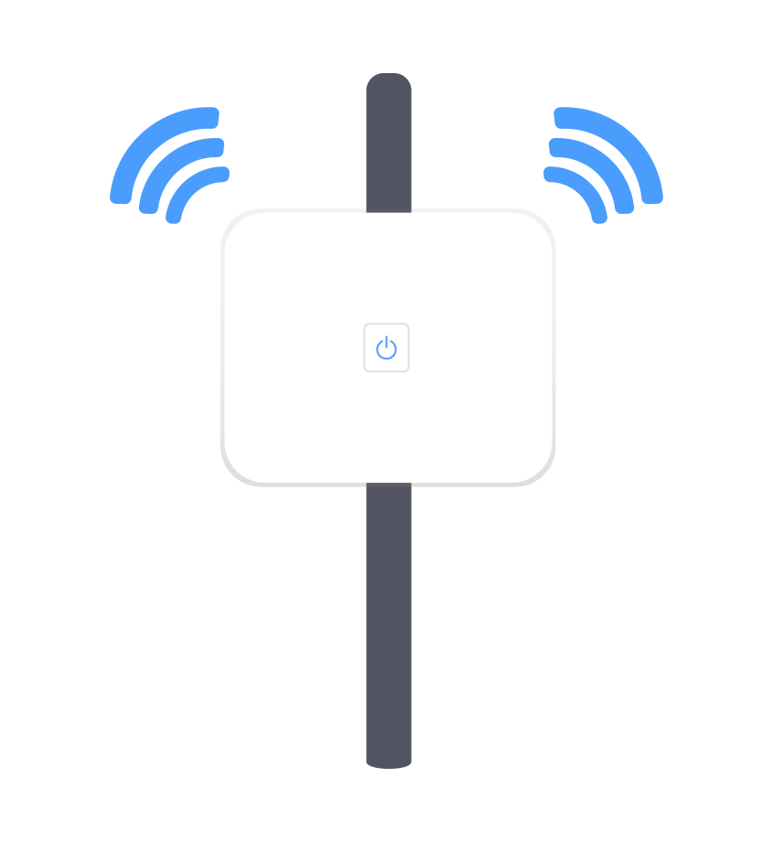
Google Cloud Associate Cloud Engineer
Network Connection Path
Client
Google PoP
Point of Presence

Slide 105

Google Cloud Associate Cloud Engineer
Network Connection Path
Client
Google PoP
Point of Presence
Google
Content Delivery Network (CDN)

Slide 106
Google Cloud Associate Cloud Engineer
Network Connection Path
NOTE!
Google themselves have a few different terms for this network, including edge nodes and Google Global Cache (GGC).
Client
Google PoP
Point of Presence
Google
Content Delivery Network (CDN)

Slide 107
Google Cloud Associate Cloud Engineer
Network Connection Path
NOTE!
The main point is that Google is caching (storing) popular static content (e.g. front page of a newspaper website).
Client
Google PoP
Point of Presence
Google
Content Delivery Network (CDN)

Slide 108
Google Cloud Associate Cloud Engineer
Network Connection Path
Client
Google PoP
Point of Presence
Google
Content Delivery Network (CDN)

Slide 109
Google Cloud Associate Cloud Engineer
Network Connection Path
But what about situations where you need to reach Google Cloud Data Centers?
For example, you actually want to use GCP to perform calculations or retrieve data from a database storage.

Slide 110
Google Cloud Associate Cloud Engineer
Network Connection Path
Let’s now imagine you were using GCP’s BigQuery tool, a data warehouse tool that allows you to ingest, store, analyze, and visualize data.
We’ll discuss BigQuery in a lot more detail later on, for now just think of it as a data tool that needs GCP access.

Slide 111
Google Cloud Associate Cloud Engineer
Network Connection Path
BigQuery

Slide 112
Google Cloud Associate Cloud Engineer
Network Connection Path
BigQuery
Google PoP
Point of Presence

Slide 113
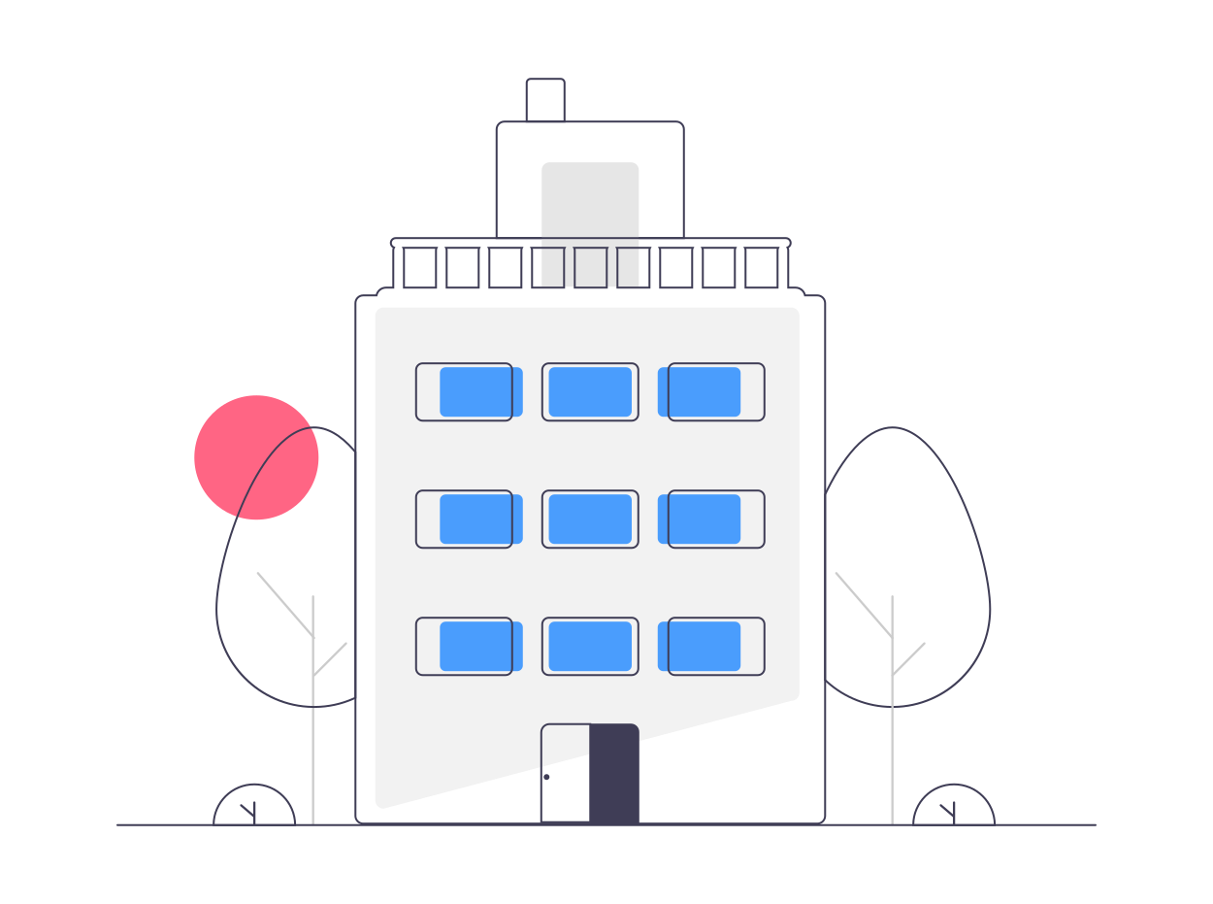
Google Cloud Associate Cloud Engineer
Network Connection Path
BigQuery
Google PoP
Point of Presence
Google
Data Center

Slide 114
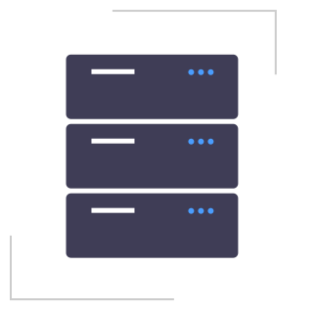
Google Cloud Associate Cloud Engineer
Network Connection Path
BigQuery
Google PoP
Point of Presence
Google
Data Center
Cluster inside
Data Center

Slide 115
Google Cloud Associate Cloud Engineer
Network Connection Path
BigQuery
Google PoP
Point of Presence
Google
Data Center
Processing

Slide 116
Google Cloud Associate Cloud Engineer
Network Connection Path
BigQuery
Google PoP
Point of Presence
Google
Data Center
Processing

Slide 117
Google Cloud Associate Cloud Engineer
As of early 2022, Google Cloud’s network spans:
29 Cloud Regions
88 Zones
146 Points of Presence
100+ CDN Edge Nodes

Slide 118
Google Cloud Associate Cloud Engineer
By the time you are watching this, these figures have probably grown even larger!
Note: They even grew during the production of this course!
Visit https://cloud.google.com/ for the latest statistics!

Slide 119
Google Cloud Associate Cloud Engineer
Review:
Google uses Edge POPs and Edge Nodes (Google Global Cache) to efficiently connect users to static content or to Google Cloud Data Centers.

Slide 120
Google Cloud Associate Cloud Engineer
Up Next:
We’ll begin to discuss the basics of actually working with the Google Cloud Platform as a user, such as dealing with security, budgets, and billing.

Slide 121
Google Cloud Associate Cloud Engineer
But first:
Let’s see a quick animation of the BigQuery network pathway we described!

Slide 122
Google Cloud Associate Cloud Engineer
Why Choose
Google Cloud Platform?

Slide 123
Google Cloud Associate Cloud Engineer
Before we conclude this section, let’s take a moment to talk about cloud computing specifically in the context of choosing the Google Cloud Platform.
What advantages does GCP bring to our cloud computing capabilities?

Slide 124
Google Cloud Associate Cloud Engineer
Google Cloud Platform Specifics:
Compute, Storage, Big Data, and ML
Open Accessibility
Security Layers
Pricing Control
Budgets and Billing

Slide 125
Google Cloud Associate Cloud Engineer
GCP organizes their cloud into 4 main categories:
Compute
Storage
Big Data
Machine Learning (ML)

Slide 126
Google Cloud Associate Cloud Engineer
Compute Services:
Compute Engine
Kubernetes Engine
App Engine
Cloud Functions

Slide 127
Google Cloud Associate Cloud Engineer
Storage:
Bigtable
Cloud Storage
Cloud SQL
Cloud Spanner
Cloud Datastore

Slide 128
Google Cloud Associate Cloud Engineer
Big Data:
BigQuery
Pub/Sub
Dataflow
Dataproc
Datalab

Slide 129
Google Cloud Associate Cloud Engineer
Machine Learning:
Natural Language APIs
Vision API
Speech API
Translate API

Slide 130
Google Cloud Associate Cloud Engineer
Certain Google Cloud Certifications focus more on applying and using specific categories of GCP services, for example the GCP Professional Data Engineer focuses more on Big Data and ML services and their use cases.

Slide 131
Google Cloud Associate Cloud Engineer
We’ll be getting a general overview of many of these GCP services to understand their use cases and some of the basics of interacting with, managing, and using the services on Google Cloud.

Slide 132
Google Cloud Associate Cloud Engineer
Usually a big concern when working with a cloud provider is “vendor lock-in” , where by using a cloud provider it can become very difficult to migrate to another solution or provider.
Fortunately, GCP takes a very forward thinking approach for open accessibility!

Slide 133
Google Cloud Associate Cloud Engineer
GCP Open Accessibility:
Provide GCP based interfaces for other sources.
For example, Looker supports 50+ distinct SQL dialects across multiple clouds.

Slide 134
Google Cloud Associate Cloud Engineer
GCP Open Accessibility:
Provide GCP based interfaces for other sources.
For example, Google Stackdriver allows for monitoring across multiple cloud providers.

Slide 135
Google Cloud Associate Cloud Engineer
GCP Open Accessibility:
Open-source based alternatives for GCP based services.
For example, Google Tensorflow is open sourced library used for many Machine Learning applications.

Slide 136
Google Cloud Associate Cloud Engineer
GCP Open Accessibility:
Open-source based alternatives for GCP based services.
For example, GCP Bigtable uses the open source database Apache HBase as its interface.

Slide 137
Google Cloud Associate Cloud Engineer
At the base of the entire infrastructure of Google Cloud is security.
As you probably know, Google itself runs many services that have over a billion users and has different layers of security built-in throughout its entire cloud infrastructure.
Let’s take a high level overview of security…

Slide 138
Google Cloud Associate Cloud Engineer
Hardware Infrastructure Security

Slide 139
Google Cloud Associate Cloud Engineer
Physical Security at Data Centers
Secure Hardware Designs
Custom chip designs (Titan)
Cryptographic signatures on GCP Servers
Hardware Infrastructure Security

Slide 140
Google Cloud Associate Cloud Engineer
Service Deployment Security
Hardware Infrastructure Security

Slide 141
Google Cloud Associate Cloud Engineer
Communication between services is encrypted.
Service Deployment Security
Hardware Infrastructure Security

Slide 142
Google Cloud Associate Cloud Engineer
User Identity Security
Service Deployment Security
Hardware Infrastructure Security

Slide 143
Google Cloud Associate Cloud Engineer
Robust IAM (Identity and Access Management) System for identity verification with U2F support.
User Identity Security
Service Deployment Security
Hardware Infrastructure Security

Slide 144
Google Cloud Associate Cloud Engineer
Encryption of stored data
Storage Security
User Identity Security
Service Deployment Security
Hardware Infrastructure Security

Slide 145
Google Cloud Associate Cloud Engineer
GCP Internet Security
Storage Security
User Identity Security
Service Deployment Security
Hardware Infrastructure Security

Slide 146
Google Cloud Associate Cloud Engineer
GCP Internet Security
Storage Security
Google Services available on the internet register themselves with “Google Front End” (GFE), which checks certificates.
At Google’s scale, Denial-of-Service (DoS) attacks are less effective, and GCP has built-in systems to monitor for DoS.
User Identity Security
Service Deployment Security
Hardware Infrastructure Security

Slide 147
Google Cloud Associate Cloud Engineer
GCP Internet Security
Storage Security
User Identity Security
Service Deployment Security
Hardware Infrastructure Security

Slide 148
Google Cloud Associate Cloud Engineer
GCP Internet Security
Google Security Practices
Google Deployment Practices
Intrusion Detection
Software Development Practices for Libraries
External Bug Bounty
And much more!
Storage Security
User Identity Security
Service Deployment Security
Hardware Infrastructure Security

Slide 149
Google Cloud Associate Cloud Engineer
Finally, a critical part of effective cloud usage (and comfort!) is clear pricing, billing, and budget controls.
GCP offers two main features:
Fine grain friendly pricing.
Clear billing and budget practices.

Slide 150
Google Cloud Associate Cloud Engineer
Friendly Pricing:
GCP Services can offer sub-hour billing increments.
Discounts for sustained usage or committed usage.
Highly customizable Virtual Machine instances for specific resource amounts.

Slide 151
Google Cloud Associate Cloud Engineer
Clear Budgets and Pricing:
GCP offers many tools to help you understand your costs and to make sure you don’t get an unexpected bill!

Slide 152
Google Cloud Associate Cloud Engineer
Clear Budgets and Pricing:
Budgets and Alerts:
Allows you to set alerts based on percent usage of a predetermined monetary budget.
For example, alert me when 90% of $10k budget is used.

Slide 153
Google Cloud Associate Cloud Engineer
Clear Budgets and Pricing:
Billing Export:
Easily export billing information to export files, including GCP based formats, such as BigQuery.

Slide 154
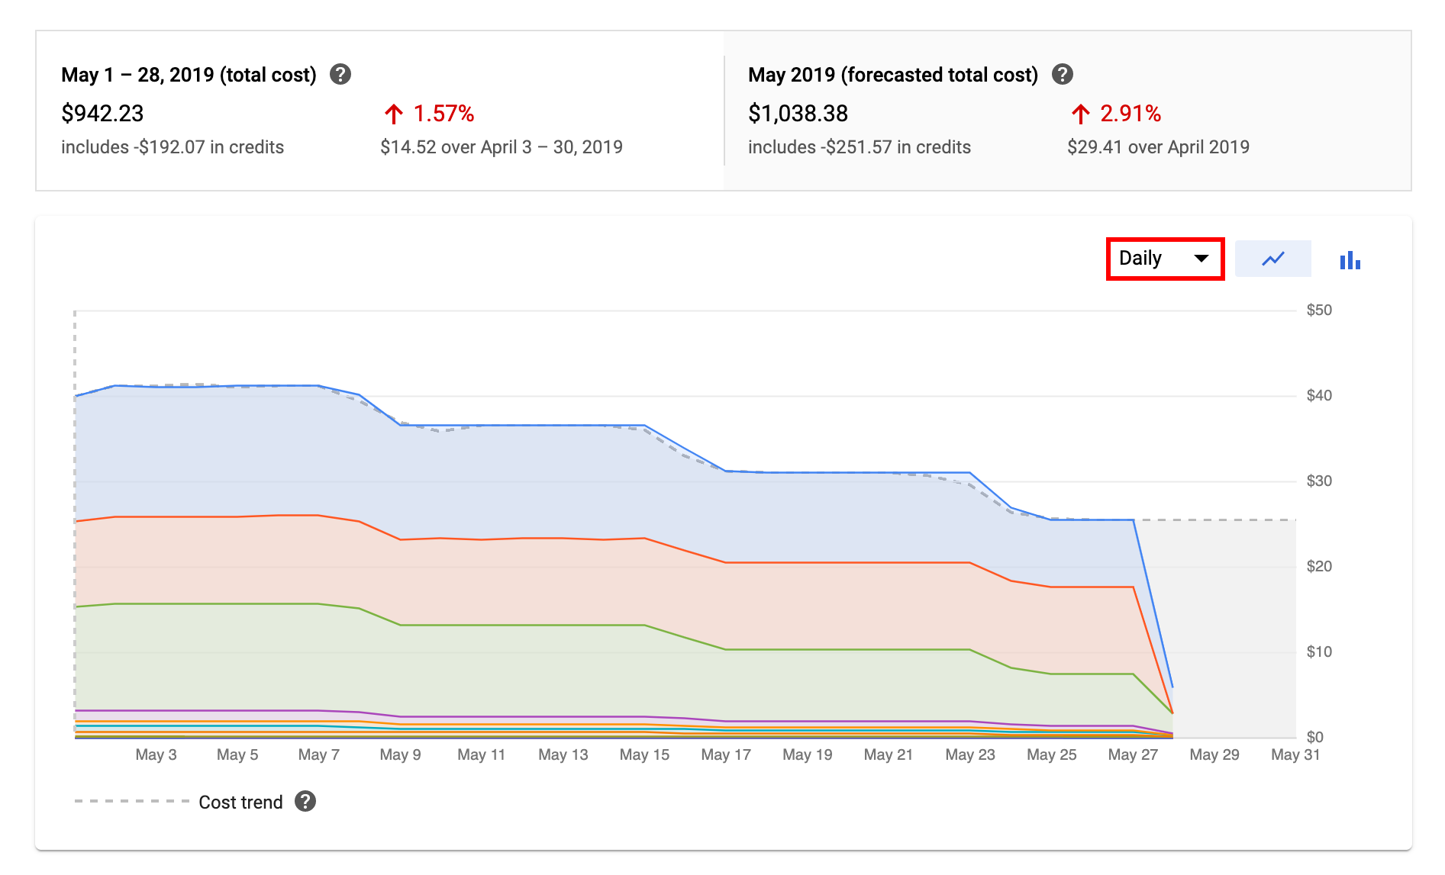
Google Cloud Associate Cloud Engineer
Clear Budgets and Pricing:
Visual Reports:
Clear graphics to monitor expenditure of GCP usage.

Slide 155
Google Cloud Associate Cloud Engineer
Clear Budgets and Pricing:
Quotas:
Rate Quotas:
Requests per Time Limits
Allocation Quotas
Resources per Project Limits

Slide 156
Google Cloud Associate Cloud Engineer
Clear Budgets and Pricing:
Quotas:
Quotas are dually designed to protect both you and GCP from potentially harmful actors.
However GCP Support can raise your quotas for certain services if you have the need.

Slide 157
Google Cloud Associate Cloud Engineer
Review:
Google Cloud Platform Specifics:
Compute, Storage, Big Data, and ML
Open Accessibility
Security Layers
Pricing Control
Budgets and Billing

Slide 158
Google Cloud Associate Cloud Engineer
Up next:
Let’s get hands-on practice!
We’ll set up our GCP Account and get a tour of the platform and basic information about key concepts for GCP account management.

